Slide 1
Future of Computing
Mack 2021

Slide 2
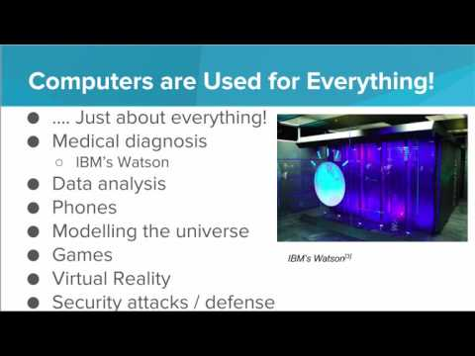
We take a look at where computing could be headed in the near future.

Slide 3
Which of the following fields use computers?
I. Computer Science
II. Medicine
III. Video Gaming
IV. Automotive (Cars)
Notes:
🍐 This is a Pear Deck Multiple Choice Slide. Your current options are: A: I, B: I, III, C: I, II, III, D: I, II, III, IV,
🍐 To edit the type of question or choices, go back to the "Ask Students a Question" in the Pear Deck sidebar.
D

Slide 4
Which of the following choices is a brand-new application of computers, having come about in the past 5 years?
Notes:
🍐 This is a Pear Deck Multiple Choice Slide. Your current options are: A: Analyzing data, B: Solving mathematical equations, C: Making predictions about future events based on data gathered about past events, D: None of the above.,
🍐 To edit the type of question or choices, go back to the "Ask Students a Question" in the Pear Deck sidebar.
D

Slide 5
Which of the following is an application of Artificial Intelligence?
Notes:
🍐 This is a Pear Deck Multiple Choice Slide. Your current options are: A: Game AI’s, B: Foreign language translation, C: Recognizing handwriting, D: All of the above,
🍐 To edit the type of question or choices, go back to the "Ask Students a Question" in the Pear Deck sidebar.
D

Slide 6
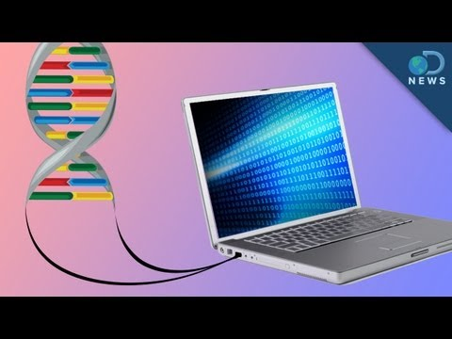
Using DNA for Storage
The computers of the future may be built using biological material.
Watch this video to learn how scientists are using DNA to store files and even use a computer access and view the files!

Slide 7
Advancing Technology
Spend about 10 minutes and think of several ways that we commonly use technology today that people couldn’t 10 years ago.
Are these uses helpful or harmful to society overall? Share your thoughts with the class.
Notes:
🍐 This is a Pear Deck Text Slide
🍐 To edit the type of question, go back to the "Ask Students a Question" in the Pear Deck sidebar.

Slide 8

Pros and Cons of AI
Not all uses of Artificial Intelligence (AI) are beneficial to society.
Here is a news report that explores how AI could help people, but also how it could be dangerous.

Slide 9
AI: Is It a Bad Thing?
Many people are scared of the rise of Artificial Intelligence (AI). Do you think computers that are controlled by an AI are something to be afraid of? Why or why not?
Notes:
🍐 This is a Pear Deck Text Slide
🍐 To edit the type of question, go back to the "Ask Students a Question" in the Pear Deck sidebar.

